Slide 1
TRAFFIC NAVIGATION AND REROUTING SYSTEM
Mudit Goel
Mukul Dev Sharma
Ravi Ranjan Kumar
Yash Bijalwan

Slide 2
INTRODUCTION TO THE PROBLEM
Integration of traffic data with navigation systems enables navigation systems to use traffic and other related data to optimise routing and travel times by taking into account traffic conditions and other disruptions to traffic flows.
Routing is the process of selecting a path for traffic in a network or between or across multiple networks. Broadly, routing is performed in many types of networks, including circuit-switched networks, such as the public switched telephone network (PSTN), and computer networks, such as the Internet.

Slide 3
METHOD/SOLUTION
We have created the traffic navigation system by using two different algorithms and have compared both of them in order to have a final outcome. The two algorithms used are:-
DIJKSTARA ALGORITHM
FLOYD WARSHAL

Slide 4
Dijkstra's Algorithm: Principles and Implementation
Step 1: Initialization
Start at the origin node and assign distances to all other adjacent nodes.
Step 2: Relaxation
Iteratively update the shortest distance to each node
Step 3: Path Construction
After processing all nodes, reconstruct the shortest path by backtracking from the destination.

Slide 5
Dijkstra's Algorithm: Principles and Implementation
Priority Queue: Initializes a priority queue with the start node.
Distances Dictionary: Sets the initial distances of all nodes to infinity, except the start node which is set to 0.
Previous Nodes Dictionary: Tracks the previous node for each node to reconstruct the shortest path.
Main Loop: Iterates over the priority queue, updating distances and previous nodes as it explores neighbors.
Relaxation: For each neighbor, calculates the new tentative distance. If it's shorter than the known distance, updates the distance and pushes the updated distance into the priority queue.

Slide 6
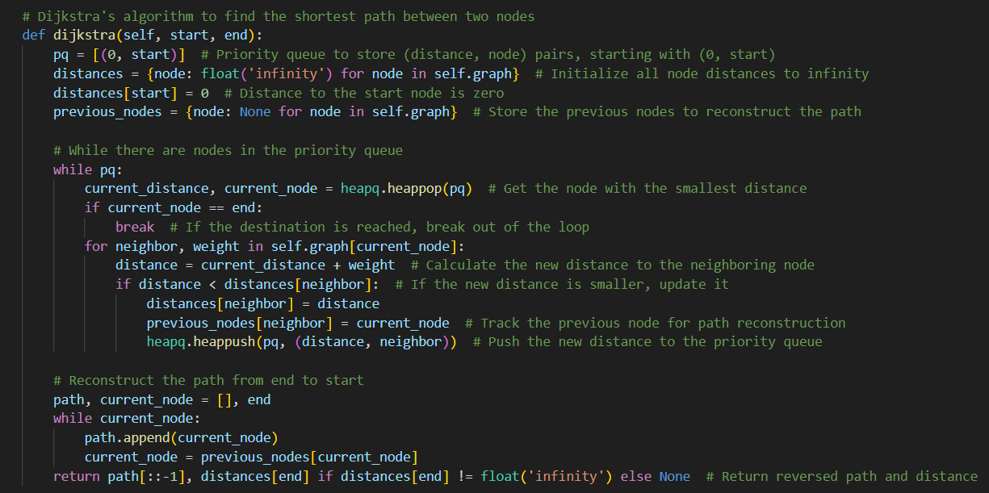
Implementation In The code

Slide 7
FLOYD WARSHALL ALGORITHM: PRINCIPLES AND IMPLEMENTATION
Step 1 : Initialization of Adjacency Matrix
Initialize the solution matrix same as the input graph adjacency matrix as a first step.
Step 2 : Execution of main algorithm
Consider each vertex k as an intermediate point. For each vertex i, check if going through k offers a shorter path from i to another vertex j. For each pair of vertices i and j, check if the direct path from i to j is longer than the path from i to j via k. If so, update the distance.
Step 3 : Update the Distance Matrix
We have to update the distance as minimum distance of all the possible pairs which will ensure that every possible shortest path is considered.

Slide 8
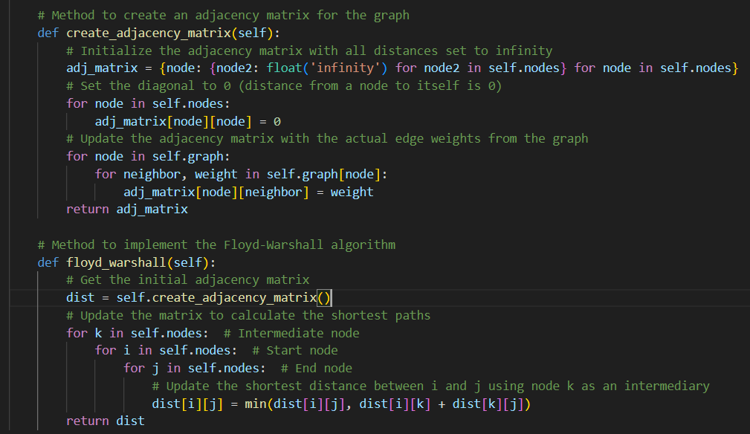
Implementation in the Code

Slide 9
Comparison
Floyd Warshall
Pros:-
All-Pairs Shortest Path: It computes the shortest paths between all pairs of nodes, making it highly versatile for applications requiring multiple-source shortest paths.
Dynamic Programming: Utilizes a dynamic programming approach to solve the problem.
Detection of Negative Cycles: It can be used to detect negative weight cycles in the graph, which can be crucial for certain applications.
Dijkstra:-
Pros:-
Simplicity: The algorithm is straightforward and relatively easy to implement.
Applicability: Dijkstra's algorithm is useful in various applications such as network routing protocols, map services, and geographical navigation systems like google maps.
Best for single-source shortest paths, where the starting point is known.
Generality: It can be used on both directed and undirected graphs and works with graphs that have non-negative weights

Slide 10
LIMITATIONS :-
Time Complexity: For large graphs, the time complexity of O(V^2) can be quite high, making it inefficient for graphs with a large number of vertices. Using priority queues (heaps) can reduce this complexity to O((E+V) log ⁡V).
Single Source Shortest Path: Dijkstra's algorithm is designed for finding the shortest path from a single source node to all other nodes. If multiple-source shortest paths are needed, the algorithm must be run separately for each source node.
LIMITATIONS :-
Time Complexity: The algorithm has a time complexity of O(V^3) which can be prohibitive for large graphs with many vertices.
High Space Complexity: The algorithm requires a V*V matrix to store distances between every pair of vertices. This leads to a high space complexity of O(V^2),which can be problematic for memory while dealing with large graphs.
No Path Reconstruction by Default: It does not provide the actual shortest path between vertices by default. Additional work is required (like maintaining a predecessor matrix) to reconstruct the paths, which adds extra overhead.

Slide 11
Applications
Urban Traffic Management:
Real-Time Navigation: Help drivers navigate efficiently through city traffic by suggesting the quickest routes based on real-time traffic data.
Traffic Congestion Reduction: Identify and suggest alternative routes to avoid congestion, especially during rush hours or in accident-prone areas.
Public Transport:
Bus Routing: Enhance public transport routing to provide faster and more reliable service to commuters.
Service Planning: Plan and adjust bus routes based on traffic conditions, improving the reliability of public transport systems.

Slide 12


DELIVERY AND E-COMMERCE
Last-Mile Delivery: In the booming e-commerce sector, efficient traffic navigation systems help delivery services optimize the “last mile” of delivery, which is often the most time-consuming part of the process.
Real-Time Location Tracking: Customers can track their deliveries in real-time, with navigation systems offering precise arrival times, live tracking, and status updates.
FLEET MANAGEMENT AND LOGISTICS
Route Planning for Delivery and Transport: Logistics companies use traffic navigation systems to optimize delivery routes for fleets of trucks, minimizing fuel consumption and reducing delays. This leads to cost savings and more efficient operations.
Tracking and Monitoring: Fleet managers can monitor vehicle locations in real-time, track delivery times, and ensure that drivers are taking the most efficient routes.

Slide 13
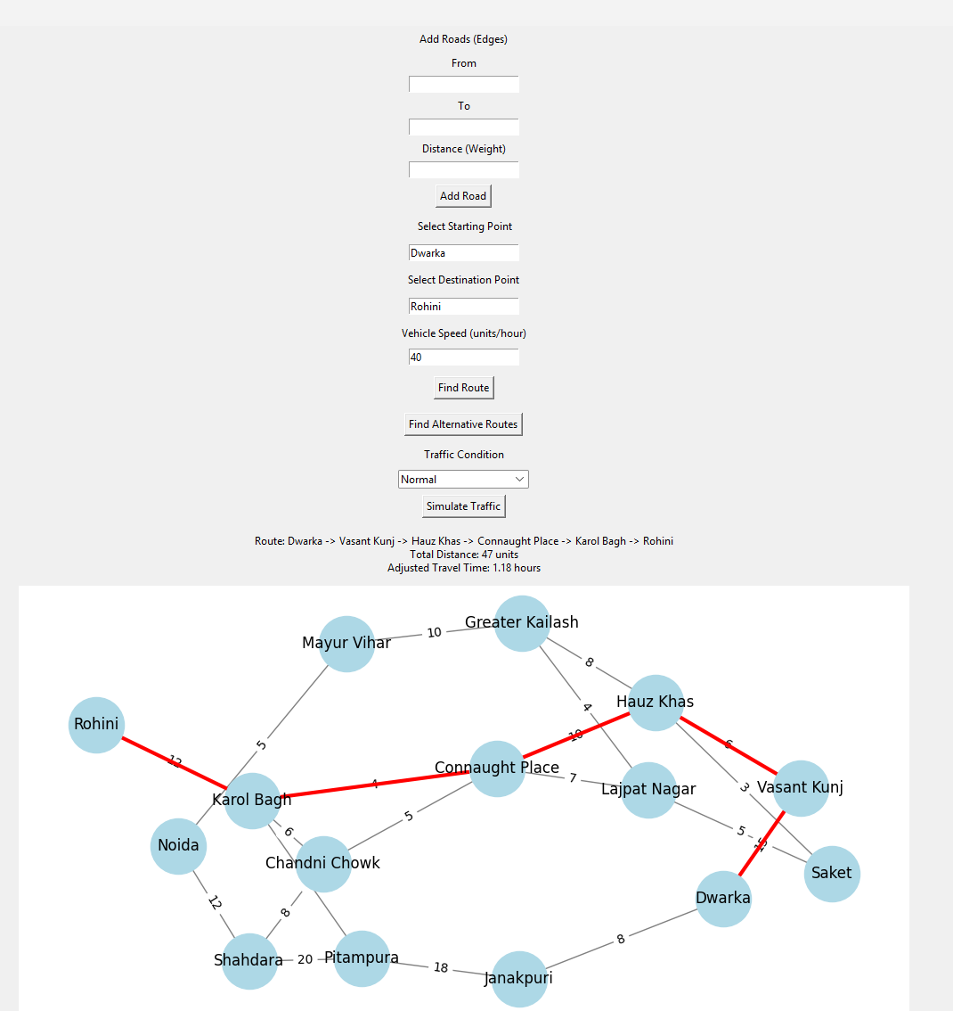
Results
Dijkstra Algorithm:-

Slide 14
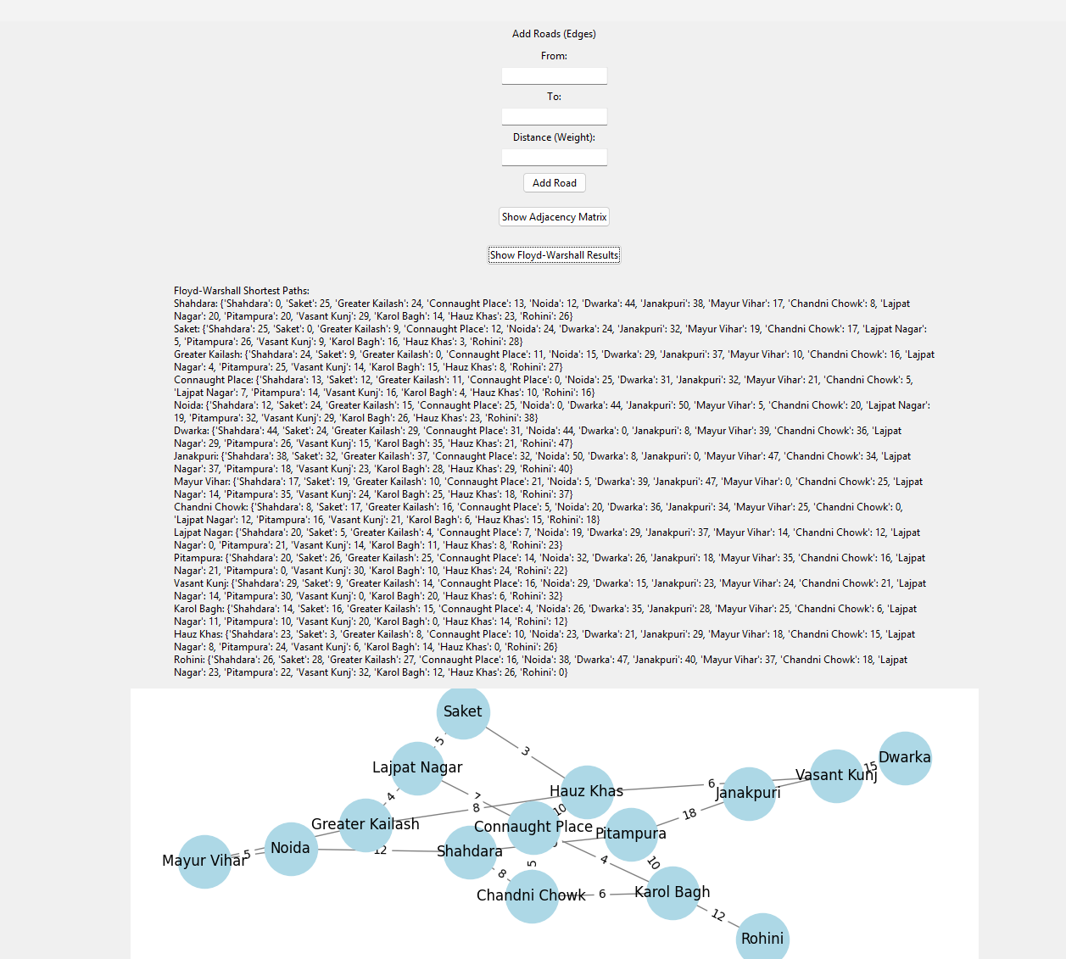
Results
Floyd Warshall Algorithm:

Slide 15
Future Scope
Some of the future advancements for the proposed system may be:-
Real-Time Traffic Prediction and Adaptive Routing
Integration with Autonomous Vehicles
AI and Machine Learning Advancements
Crowdsourcing and Collaborative Systems

Slide 16
FINAL VERDICT
For Traffic Navigation: Dijkstra's Algorithm is more efficient for applications needing quick, single-source shortest path calculations. Such as individual route planning or dynamic rerouting based on traffic conditions.
For Comprehensive Mapping and Static Systems: Floyd-Warshall Algorithm is more suited for static systems requiring a detailed map of all shortest paths, such as pre-computed navigation systems and network analysis tools.
Additionally, Floyd-Warshall can be beneficial in scenarios where the navigation system needs to pre-calculate all possible routes to provide instant responses, while Dijkstra excels in scenarios requiring real-time data adaptation and lower memory usage.

Slide 17

References:
https://www.geeksforgeeks.org/floyd-warshall-algorithm-dp-16/
https://www.geeksforgeeks.org/introduction-to-dijkstras-shortest-path-algorithm/

